Slide 1
Rockbuster Stealth, LLC From Storefronts to Streaming
July 2025
Lisa Danen

Slide 2
Objectives & Business Questions
As Rockbuster Stealth looks ahead to the launch of an online streaming platform, we want to answer key questions and provide insights to support data-driven decision-making.
The following slides cover the insights gleaned from analysis of company data about movies, customers, payments and other key details.
The following questions will be answered:
What was the average rental duration for all videos?
Which countries are Rockbuster customers based in?
Where are the customers with a high lifetime value based?
Do sales figures vary between geographic regions?
Which movies contributed the most/least to revenue gain?

Slide 3
Current Statistics
Currently, the average movie in the Rockbuster library is 115.3 minutes long, and rents for 5 days, at a rental rate of $2.98. The cost to replace a movie averages $19.98.
Rental Rate
Minimum: $0.99 Maximum: $4.99 Average: $2.98
Rental Duration
Minimum: 3 days
Maximum: 7 days
Average: 5 days
Movie Length
Minimum: 46 minutes
Maximum: 185 minutes
Average: 115.3 minutes
Replacement Cost
Minimum: $9.99
Maximum: $29.99
Average: $19.98

Slide 4

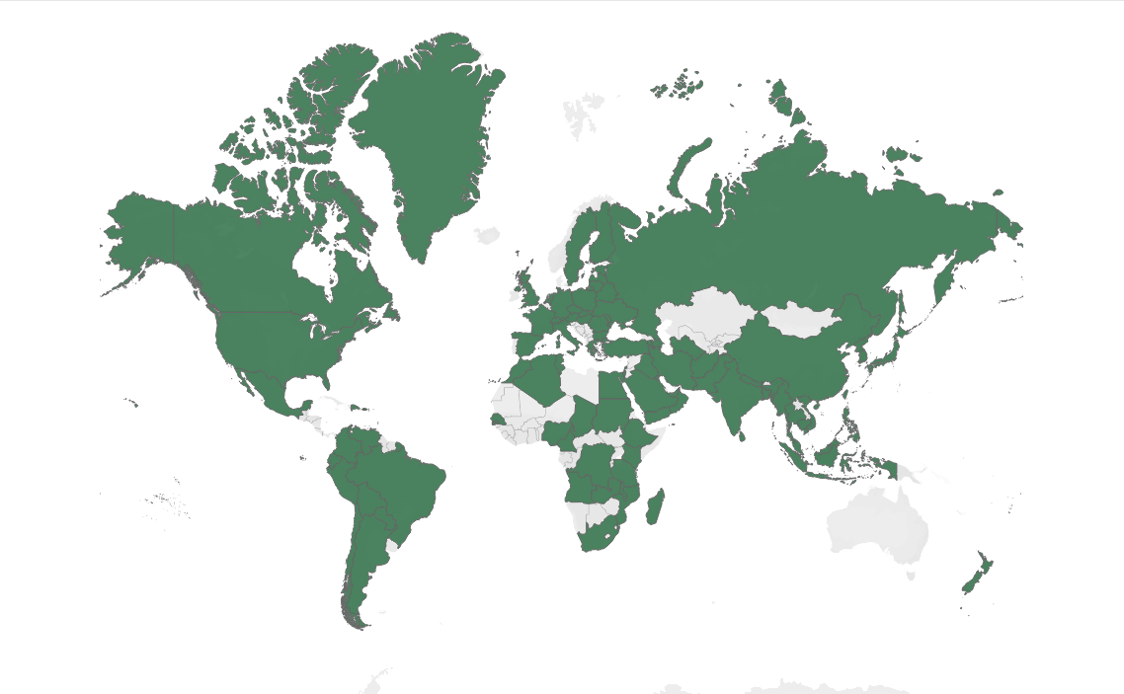
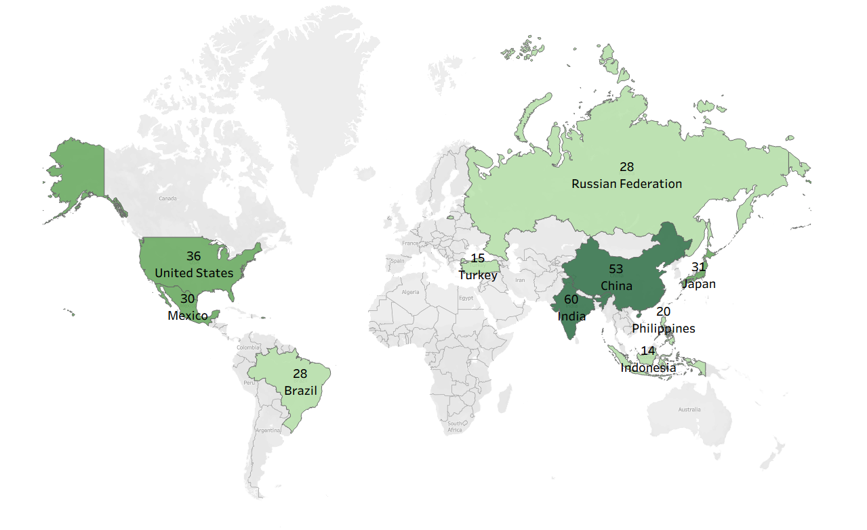
Where are Rockbuster Customers?
Rockbuster Stealth has a truly global presence!
Customers in 109 Countries
Top 10 Countries
As shown here, India and China have the highest number of Rockbuster customers.

Slide 5
Where are the customers with the highest lifetime value based?
Three of Rockbuster’s top 5 customers are located in North America (2 in Mexico and 1 in the US)
and the other 2 are in Asia, again reflecting the global nature of the overall customer base.
Customer Name | City | Country | Lifetime Spend
Sara Perry | Atlixco | Mexico | $128.70
Gabriel Harder | Sivas | Turkey | $108.75
Sergio Stanfield | Celaya | Mexico | $102.76
Clinton Buford | Aurora | United States | $98.76
Adam Gooch | Adoni | India | $97.80

Slide 6
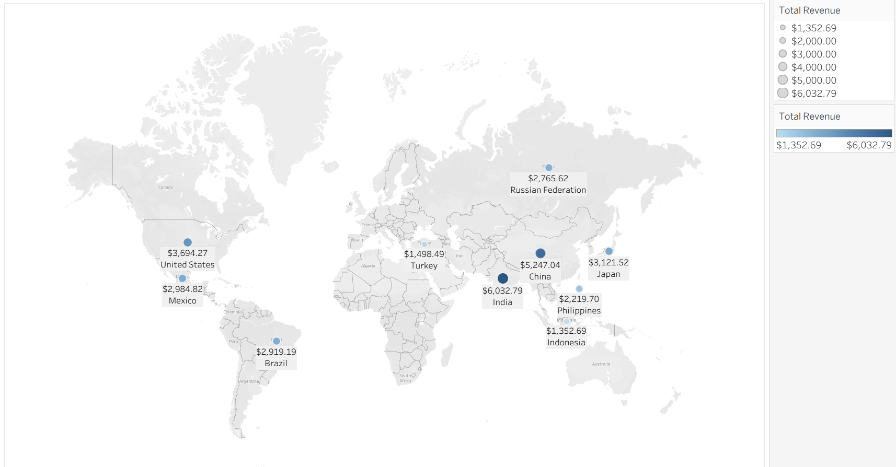
Do sales figures vary between geographic regions?
This map reflects the top 10 markets by revenue.
Not surprisingly, they are the same top 10 that we saw with regards to the number of customers.

Slide 7
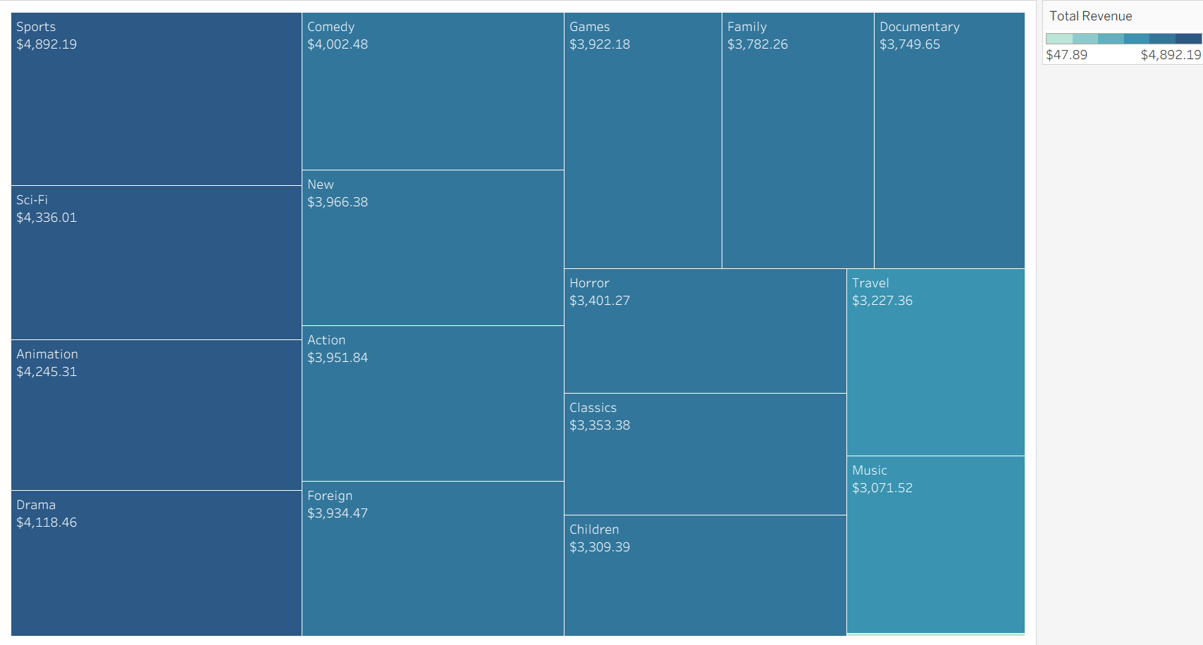
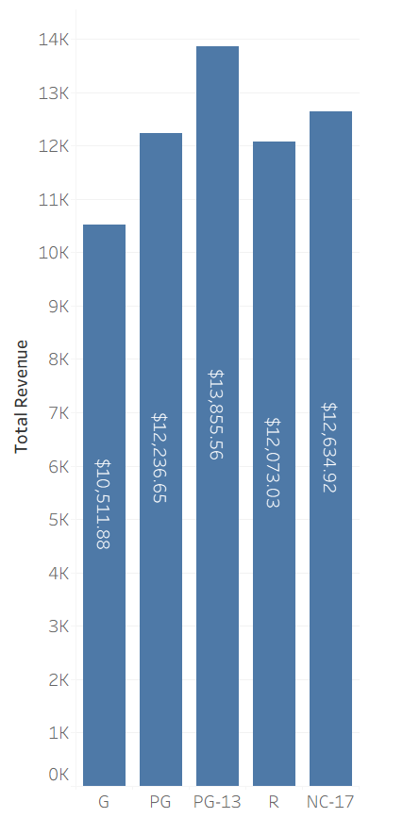
What movies produce the most revenue?
Total Revenue by Genre
Total Revenue by Rating
Sports, Sci-Fi, Animation, Drama and Comedy movies are the biggest
revenue generators, though many genres are strong contributors.
The top revenue-generating rating is PG
and the lowest is G.

Slide 8
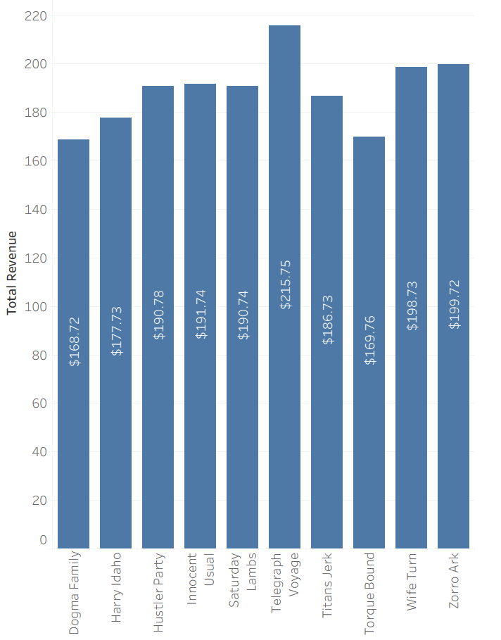
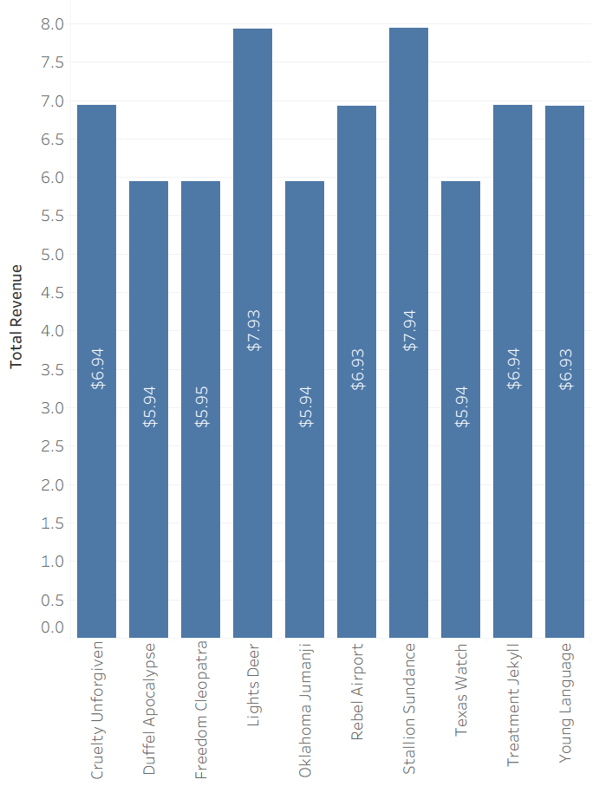
Which specific movies contributed most and least to revenue?
Top 10 Movies by Revenue
Bottom 10 Movies by Revenue
Here we see that some
movies bring in very little
total revenue, making them
logical candidates for removal
from the Rockbuster library.

Slide 9
Insights & Recommendations
Insights
India and China have the largest customer base and generate the most revenue, followed by the US, Japan, and Mexico.
There is minimal difference in revenue generation across most genres, reinforcing the value of a diverse content library. Movies rated PG-13 generate the most revenue, which offers an area of focus for growing the content library.
The average rental duration is 5 days. However, this metric is less relevant in a digital model.
Recommendations
Continue to focus marketing in Asia and North America to capitalize on the strong existing customer base in those areas.
Create a loyalty rewards program for customers who reach a threshold of lifetime spend, to maximize retention.
Maintain a diverse library, while removing the lowest-performing movies to reduce licensing fees.
Focus on providing streamlined, user-friendly online platform that makes accessing on-demand movies easy.

Slide 10
Thank you!
Link to visualizations in Tableau Public: https://public.tableau.com/app/profile/lisa.danen/viz/DataImmersion3_10finalvisualizations/WhereareRockbusterCustomers2?publish=yes

